Slide 1
Advanced Image Analysis
2017-2018, 2nd semester
Color images
Alessandro Bria
Contract Professor
and Post-doc Researcher
email: a.bria@unicas.it

Slide 2
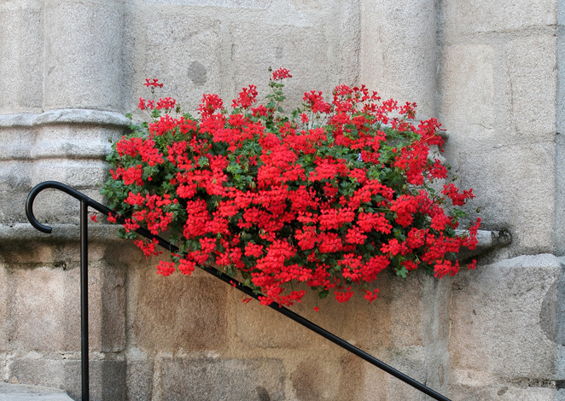
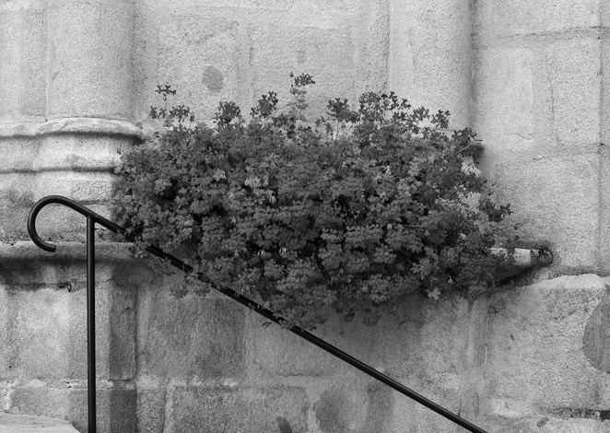
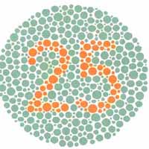
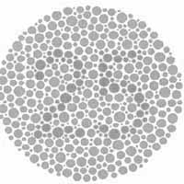
Color images
color is a feature that can greatly improve the description of the scene
the shades of colors the can be discriminated by the human visual system are much more than the gray ones (thousands vs. dozens)
the color can be studied as:
a physical phenomenon
a perceptive phenomenon

Slide 3
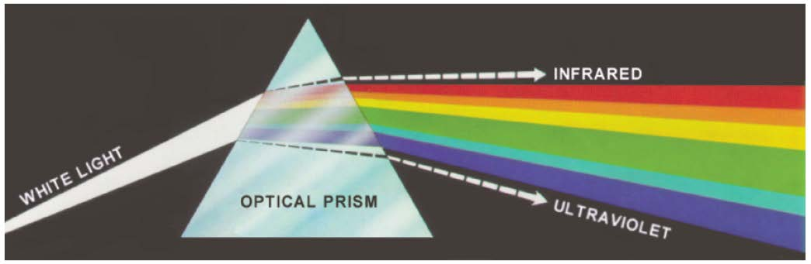
Physical nature of the color
where do colors come from?
white light decomposition (Isaac Newton, 1666)

Slide 4
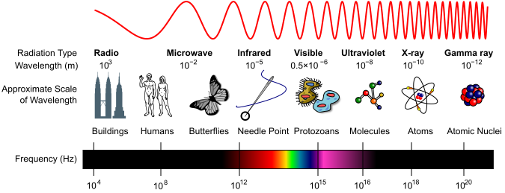
Physical nature of the color
chromatic light is just a small portion of the electromagnetic spectrum

Slide 5
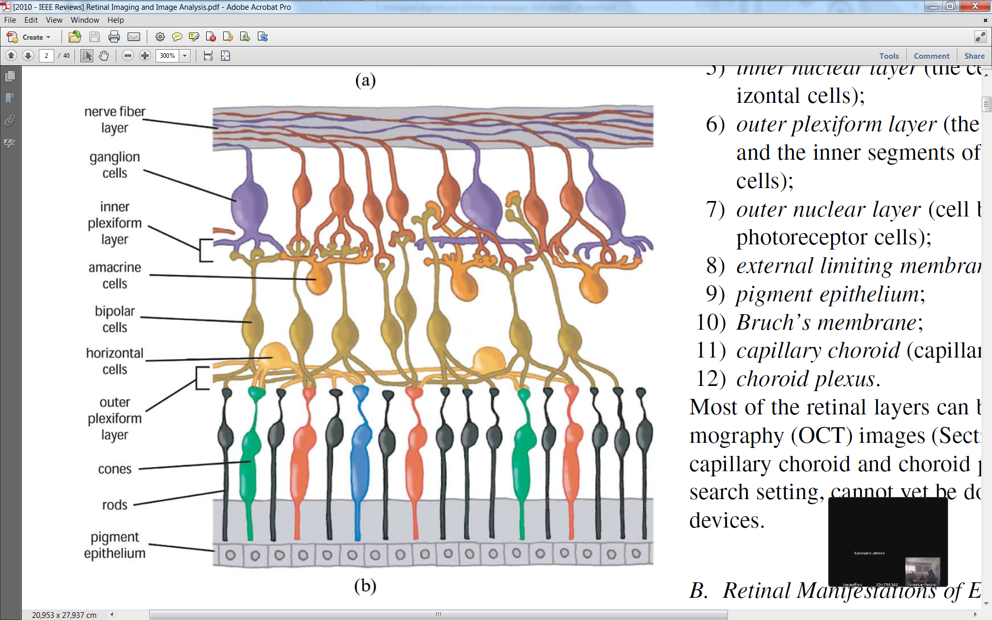
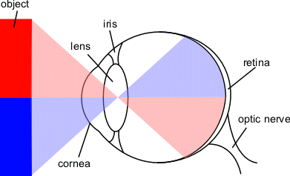
Color perception
humans see colors thanks to photoreceptors cells present in the retina
cones (~7 millions): sensitive to colors; low overall sensitivity
rods (~75-150 millions): not sensitive to colors; high overall sensitivity

Slide 6
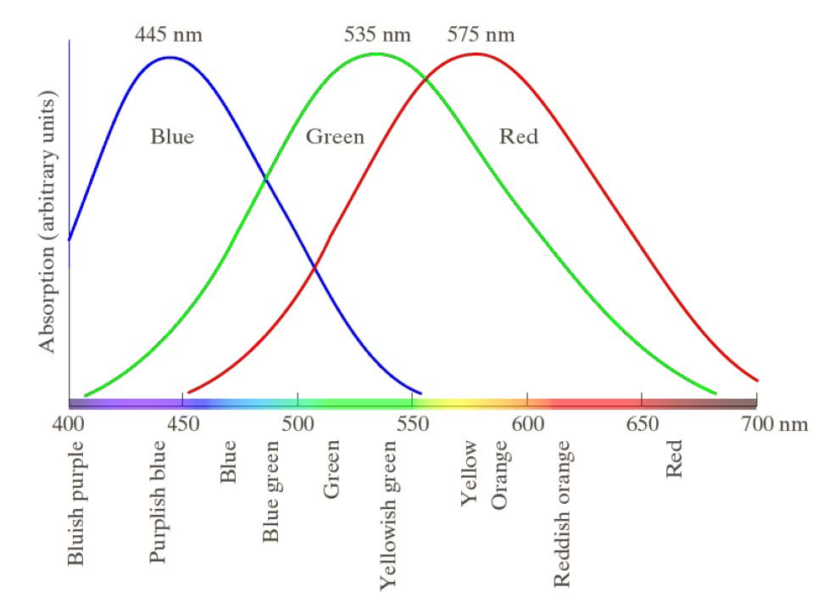
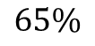
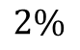
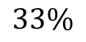
Color perception
photopic vision
each perceived color results from the activation of the cones belonging to the different types
$$33\%$$
$$2\%$$
$$65\%$$
You do like this
You do not like this

Slide 7
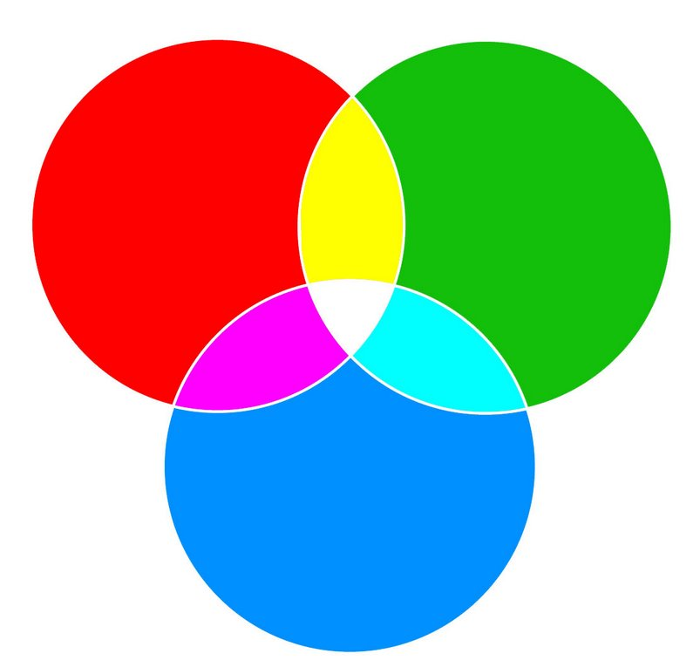
Primary and secondary colors
colors are seen as variable combinations of the so called primary colors of light red (R), green (G), and blue (B)
mixing the primary colors, most of the visible colors of light can be obtained;
in particular, the secondary colors cyan (C), magenta (M), and yellow (Y)

Slide 8
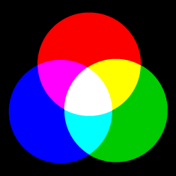

Additive and subtractive colors
additive color mixture begins with the absence of light (black), and adds colors of light together to form new colors
used in theatrical lighting, and in computer monitors and TV screens (RGB is the most used color model)
subtractive color mixture begins with the presence of all colors (white), and subtracts, or absorbs, colors of light from the white light to form new colors
used in printers (CMYK is the most used color model)
C, M, Y are the so called primary colors of pigments

Slide 9
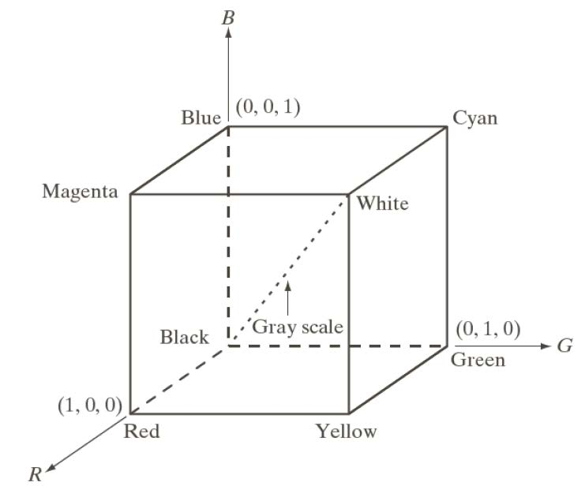
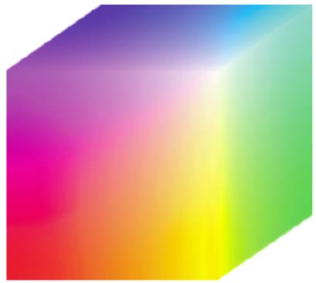
RGB color model
each color is represented by its primary spectral components of R, G and B based on a Cartesian coordinate system

Slide 10


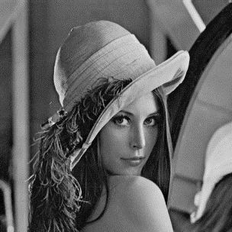
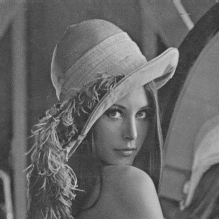
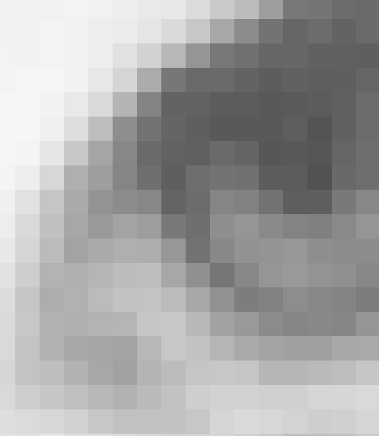
RGB color model
images represented in the RGB color model consist of three component images, one for each primary color
Red
Green
Blue
gray level intensity

Slide 11
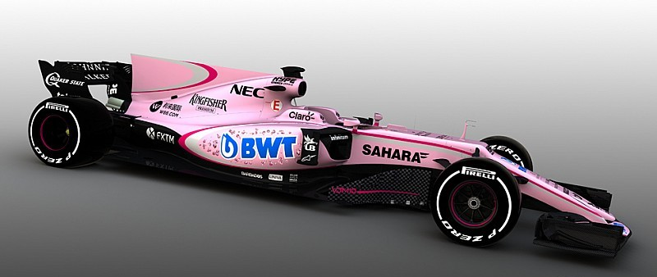
HSI color model
RGB and other similar color models (e.g. CMY) are not suited for describing colors in terms that are practical to human interpretation
one does not refer to the color of an automobile by giving the percentage of each of the primaries composing its color
we do not think of color images as being composed of three primary images that combine to form that single image

Slide 12
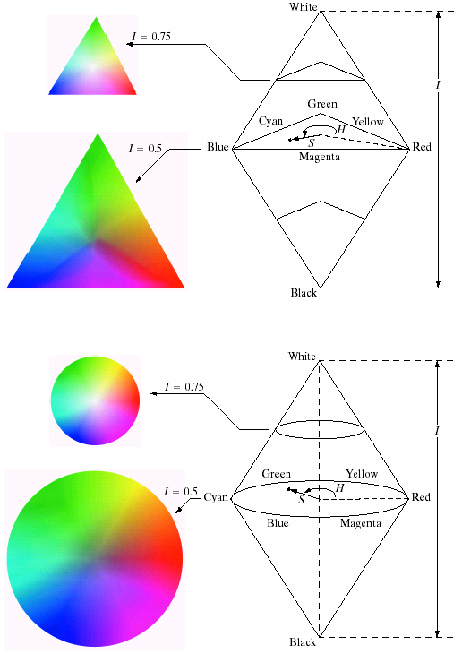
HS* color model
when humans view a color object, we describe it by its:
hue (H): the dominant color
saturation (S): color purity (pink is half saturated red)
brightness (B/V), or lightness (L), or intensity (I): amount of light

Slide 13
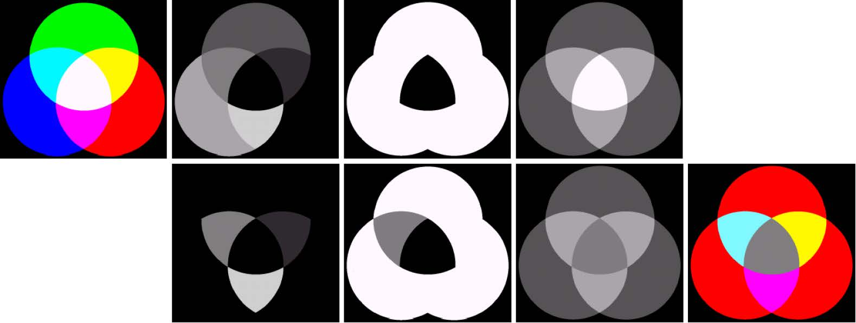
HS* processing example
processing can be more easy in HS* space, since its effects are more predictable in terms of color modification
H
S
V

Slide 14
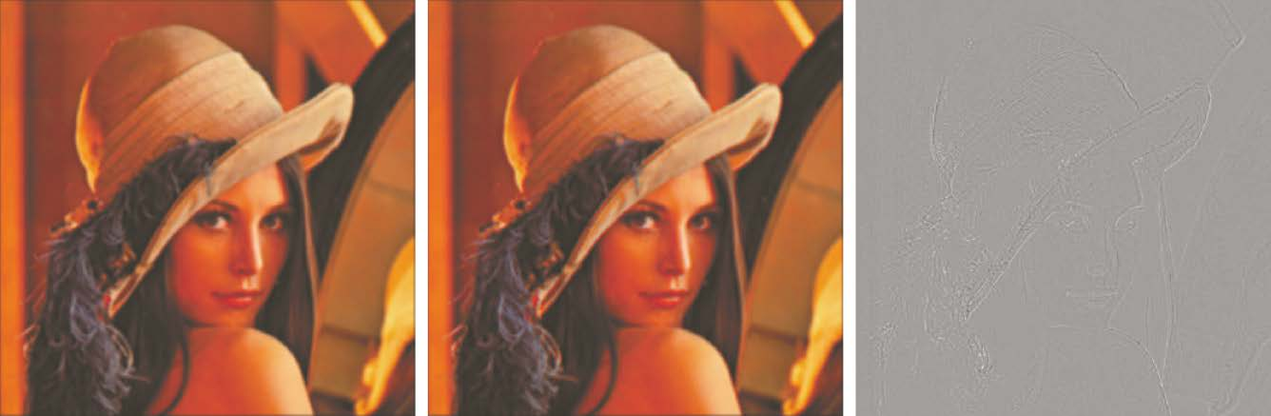
Color image processing: spatial filtering
e.g. smoothing
smoothing in R,G,B
smoothing in V
difference

Slide 15
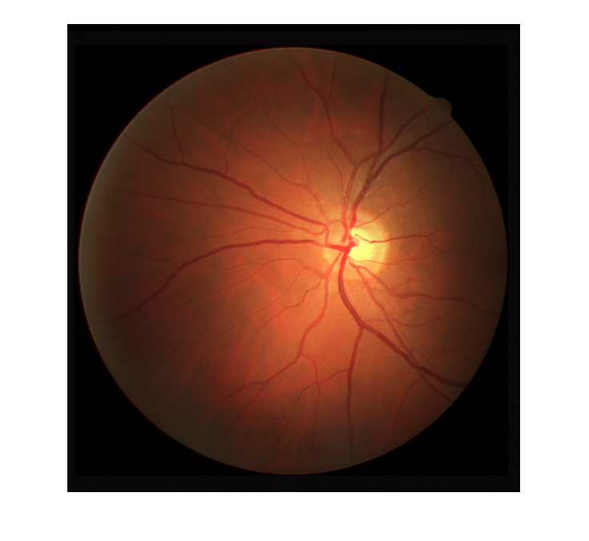
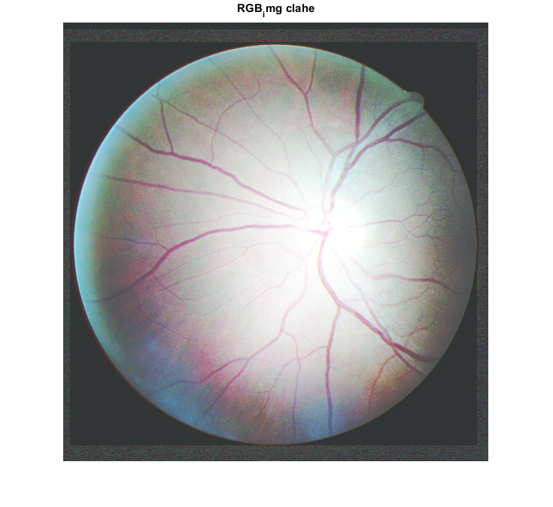
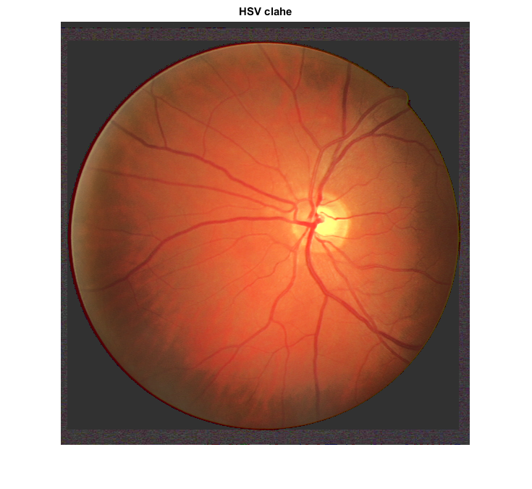
Color image processing: histogram equalization
the choice of the color model can matter...
original image
histogram equalization in R,G,B
histogram equalization in V

Slide 16
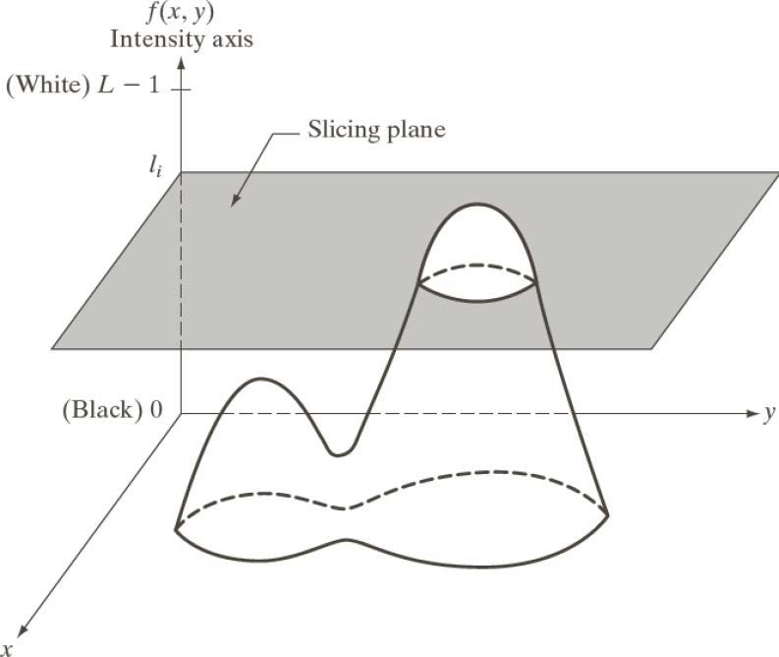
Pseudocolor image processing
pseudocolor (also called false color) image processing consists of assigning colors to gray values based on a specified criterion
e.g. intensity slicing
the image is interpreted as a 3-D function (intensity versus spatial coordinates)
planes are placed parallel to the coordinate plane of the image
each plane then "slices" the function in the area of intersection
a different color is assigned to each plane

Slide 17
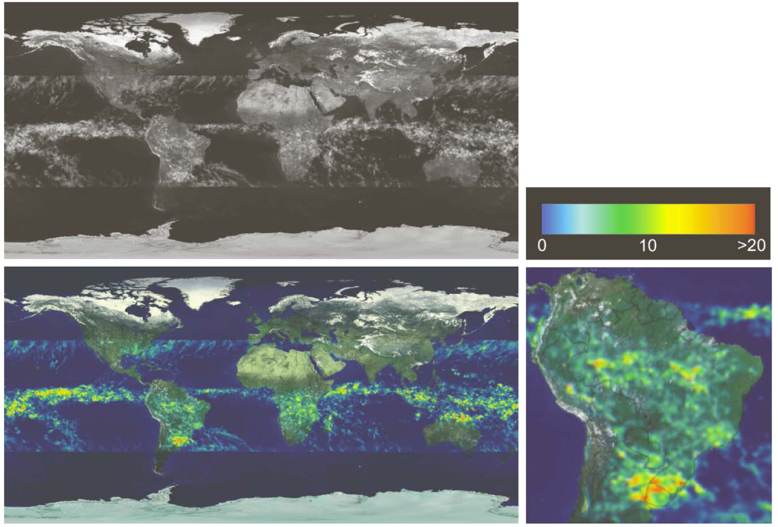
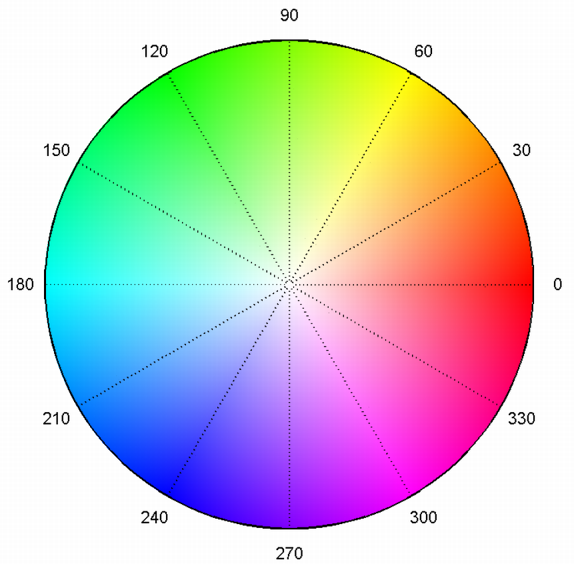
Pseudocolor image processing: heat maps
intensity slicing mapping intensity to H (between 240° and 0°) yields heat maps

